Slide 1
Ocular Albinism&Nystagmus Management
Dr. Soeung Soryoun
CSC

Slide 2
Outline
Review of Albinism
Diagnosis-Albinism
Features of Albinism
Case presentation
Nystagmus
Kinds of nystagmus
Study, literature review
Our treatment
Post-op video
Post-op VA
Conclusion/Summary
References

Slide 3
Albinism
The term albinism comes from the Latin word albus, which means white
refers to a group of hereditary disorders that involve an abnormality of melanin pigment biogenesis (melanin synthesis or distribution).
Albinism presents as a pigmentation abnormality of the skin, the hair, and/or the eyes
Notes:
Synthesis occurs in melanosomes present in melanocytes
of in melanin pigment biogenesis(melanin synthesis or distribution).

Slide 4
Albinism
Can be divided into 2 broad categories
Oculocutaneous albinism involves both the skin and the eyes
Ocular albinism mainly affects the eyes with minimal to no skin involvement.
The frequency of oculocutaneous albinism is approximately 1 in 17,000 to 1 in 20,000.
The prevalence of X-linked ocular albinism is estimated to be 1 in 50,000.
Notes:
Oculocutaneous albinism is most severe form resulting from a deficiency of tyrosinase activity, causing a total absence of pigment from the hair, eyes & skin

Slide 5
OCA &OA
Notes:
Oculocutaneous albinism is most severe form resulting from a deficiency of tyrosinase activity, causing a total absence of pigment from the hair, eyes & skin

Slide 6
Ocular albinism
Ocular albinism type I (OA1gene) Nettleship-Falls syndrome, is an X-linked disorder is the most common form of ocular albinism.
Absence of pigmentation leads to foveal hypoplasia and abnormal decussation of optic nerve.
It has been postulated that retinal pigment epithelial around the macula is necessary for the normal development of the fovea
Notes:
There, partial decussation occurs, and about 53% of the fibers cross to form the optic tracts. Most of these fibres terminate in the lateral geniculate body.

Slide 7
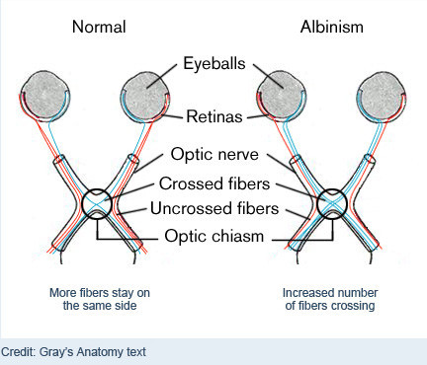

Slide 8
The inheritance pattern of albinism
OA
OCA

Slide 9
6y/o girl present to CSC with
Blurred vision
Involuntary eye movements
Photophobia

Slide 10
video

Slide 11
Ocular exam :
VA: CF2m UCVA
Horizontal pendular nystagmus w/mild rotational component
Transillumination Iris Defects
Hypopigmentation of the fundus with clearly visible choroidal vessels+foveal hypoplasia

Slide 12
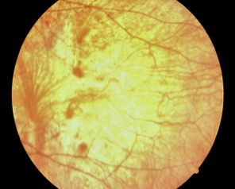
TID
Retinal hypopigmentation

Slide 13
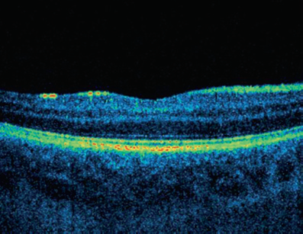
Oct with fovea hypoplasia
Notes:
1-OCA,.2-OA and normal oct

Slide 14
Management for albinism
Early detection and correction of refractive errors
Sunglasses or special filter glasses for photoaversion
Management of associated nystagmus
Prismatic spectacle correction for abnormal head posture associated with null point
Nystagmus correction with surgery can be considered

Slide 15
Review of Nystagmus
Condition that causes involuntary, rapid movement of one or both eyes.
Can be pendular, jerking, upbeat, downbeat, rotational movement, periodic alternating
Nystagmus is often accompanied by vision problems

Slide 16
Two basic types of nystagmus
Congenital nystagmus
Present within the first 6 months of life and associated with decreased vision
Studies suggest 1 in every 1000 children have nystagmus
Subtypes
(1) nystagmus associated with albinism
(2) latent and manifest latent nystagmus
(3) spasmus nutans
Acquired nystagmus
later in life and is associated with neurological disorders
Notes:
LMLN is happened with covered one eye at the time
Spasmus nutans is associated with AHP

Slide 17
Causes of Congenital Nystagmus
In 80-90% of cases, it is a side effect of vision loss from eye diseases such as:
Albinism
Aniridia
Bilateral optic nerve hypoplasia
Bilateral congenital cataracts
Optic nerve or macular disease
Persistent hyperplastic primary vitreous
Rod-cone dystrophy
ROP or coloboma
Notes:
diopathic infantile nystagmus is believed to be due to a primary abnormality in oculomotor control
Early (usually bilateral) visual deprivation (eg), congenital cataracts, severe glaucoma, Peters anomaly^{[4]}
Foveal hypoplasia (eg, aniridia, albinism [nystagmus associated with albinism has characteristics similar to idiopathic infantile nystagmus])
Retinal disease (eg, Leber congenital amaurosis, achromatopsia, macular toxoplasmosis [especially if bilateral])
Retinal detachment (eg, severe retinopathy of prematurity, posterior persistent hyperplastic primary vitreous, familial exudative vitreoretinopathy)
Optic nerve abnormalities (eg, hypoplasia, coloboma, atrophy)
Cortical visual impairment from perinatal insult or structural CNS abnormality

Slide 18
Acquired nystagmus
Later in life from neurological dysfunction:
Head injury
multiple sclerosis or brain tumors
Inner ear disorders-labyrinthitis, Meniere's disease
Stroke
Medication -Dilantin and Phenobarbital
Excessive alcohol
Paraneoplastic syndrome -opsoclonus
Notes:
Paraneoplastic-neuroblastoma with opsoclonus

Slide 19
Pathophysiology
All nystagmus degrades visual acuity by reducing the stability of fixation and lessening foveation time
Afferent (sensory deficit) nystagmus, due to visual impairment, most often from sensory origin-such as cataract
Efferent (idiopathic infantile) nystagmus, due to neurological or oculomotor abnormality

Slide 20
Imaging Studies
Intial work-up: look for space-occupying lesions or brain abnormality
Spasmus nutans - MRI to rule out glioma if evidence suggests an anterior visual pathway or hypothalamic disease.
Aniridia – risk Wilms tumor, periodic renal ultrasound.
Optic nerve hypoplasia - risk of midline CNS abnormalities, (absence of the corpus callosum or pituitary ectopia); evaluate pituitary function for endocrine evaluation.
Ocular ultrasonography – assess retina in cataract, Peters anomaly, and other disorders in which the ocular fundus cannot be visualized. Used for diagnosis of persistent hyperplastic primary vitreous, and to assess the status of the retina in advanced retinopathy of prematurity, familial exudative vitreoretinopathy, and perinatal trauma.
Notes:
Wilms' tumor is a rare kidney cancer that primarily affects children. Also known as nephroblastoma, Wilms' tumor is the most common cancer of the kidneys in children. Wilms' tumor most often affects children ages 3 to 4 and becomes much less common after age 5
-corpus colusum is white matter between right and left hemisphere

Slide 21
Medical treatment
Baclofen(antispasticity)- GABA agonists or inhibitors of the excitatory and has been effective in treating the periodic alternating nystagmus (PAN) subtype.
Gabapentin (Neurontin) is a medication used as an anticonvulsant and analgesic and also beneficial in congenital nystagmus, with an improvement in foveation time of vision and decrease in amplitude and frequency of the nystagmus
Botox Used in treatment of nystagmus by injection into specific extraocular muscles and retrobulbar placement within the muscle cone.

Slide 22
Force accommodation with prism which can reduce nystagmus
Contact lens wear diminish infantile nystagmus by avoiding induced spectacle distortion with ocular movement in patients with high degrees of ametropia.
Notes:
Is base out prism to force convergence nystagmus

Slide 23
Surgical management
Extraocular muscle surgery to correct:
A head turn by shifting the null point closer to the primary position.
Improve visual acuity by decreasing nystagmus intensity and therefore improving foveation time.

Slide 24
Type of surgery for Nystagmus
Kestenbaum-Anderson’s procedure
Large 4-horizontal rectus muscle recession
Four Horizontal Rectus Muscle Tenotomy and Replacement (TAR)

Slide 25
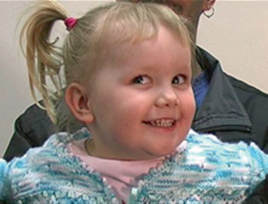
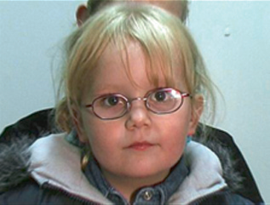
Kestenbaum-anderson’s
Notes:
For example, if a patient with congenital nystagmus has a left face turn and null zone in right gaze, the eyes are surgically rotated to the left by recession of the right lateral and left medial rectus muscles and by resection of the right medial and left lateral rectus muscles. This makes it more difficult for the patient to look into right gaze, thereby damping the nystagmus more toward the primary position

Slide 26
Kestenbaum-Anderson’s procedure
The eyes are surgically rotated toward the direction of the head turn and away from the null zone or preferred position of gaze.
Each eye undergoes a recession-resection procedure to move the eyes in the same direction.

Slide 27
Large four horizontal rectus muscle recession
In case series by Işıkçelik et.al, 12 patients underwent this surgery, 2/3 were noted to have subjective improvement, and objectively stereopsis improved
Notes:
Discuss article: In case series by AUTHOR, 12 patients underwent this surgery, 2/3 were noted to have subjective improvement, and objectively stereopsis improved
The records of the 12 patients who had four horizontal rectus muscle
recession surgery were evaluated and six patients (5 male, 1 female) who
had regular follow-ups were included in this study. Mean follow-up was
14.17 ± 0.41 years (minimum 14 years, maximum 15 years) and mean age of
patients at the last visit was 22 years (20-28 years). On subjective
evaluation, two-thirds (4/6) of the patients were satisfied with the
surgical results and had the impression that after surgery, nystagmus decreased
in intensity and head posture improved. On objective evaluation, visual
acuity was found to be the same, however, stereopsis improved
(preoperatively and postoperatively median stereopsis was 600 sec arc vs
200 sec arc final). The decrease in nystagmus amplitude and frequency was
still maintained.
CONCLUSIONS:
Nystagmus surgery on four horizontal rectus muscles has positive effects on
binocular function and nystagmus parameters in the long-term follow-up. As
we could not treat the primary pathology, the visual acuity was about the
same but the decrease in nystagmusamplitude and frequency was still
maintained with better stereopsis, and patient satisfaction.

Slide 28
Four Horizontal Rectus Muscle Tenotomy and Replacement (TAR)
Disinserting and reattaching the horizontal rectus muscles, without recession or resection may be beneficial to damp the nystagmus and improve visual function.
In the review by Graven and Nelson:
describe several cases series found these individuals experienced therapeutics beneficial of surgery including broadening of the null region, increased visual acuity in and outside of the null region, and improved nystagmus waveforms
Notes:
Reference article

Slide 29
Case study: Post-op VA
BCVA w/-2.0D sph improved to 6/60,OU

Slide 30
Conclusion
Large 4 muscle horizontal rectus recessions have been reported to improve visual acuity in some patients with nystagmus

Slide 31
References
Mark Ventocilla, OD, FAAO; Title. Accessed http://emedicine.medscape.com/article/1200103-overview
Romano SQ. Effect of Four Horizontal Rectus Muscle Tenotomy and Replacement (TAR) Alone and in Combination with Recessions for Strabismus, on Visual Function and Eye Movements in Patients with Infantile NystagmusSyndrome (INS) Without Abnormal Head Posture (AHP). Binocul Vis Strabolog. 2013;28(4):211-21.
Eugene M. Helveston The Strabismus Minute, Vol.1, No. 21, 1999
Nelson B.
Işıkçelik Y. The effect of horizontal rectus muscle surgery on clinical and eye movement recording indices in infantile nystagmus syndrome. Strabismus. Jun;18(2):58-64

Slide 32
Thank you for your attention!!

